Slide 1
CHARTS AND GRAPHS

Slide 2
Introduction
Charts are mainly used to generate a graphical representation of the given datasets.
Diagrammatical representation of information in which the information shown in the form of a circle,bar,line etc.,
It helps the user to understand the information better and make data visualization simpler.

Slide 3
PIE CHART
Pie charts gives more visibility.It is represented as circle.
The circle is made of various parts:each part is marked as numbered
Aggregate value of pie chart is always=100%
This chart is easy to read where each part tells us what the size of the dataelement is.
Pie() generates the pie chart.
It can take any number of arguments.
Pie chart is used to display information related to marketing, weather reports, and finance etc.,

Slide 4
Syntax: pie(arguments)
Pie(part,labels,edges,radius,clockwise,init.angle,density,angle,col,main)
Part: contains a vector of non-negative numeric values and tells the size of parts.
Labels:used to assign names to each part
Edges:used to change the outer circle of the pie; the default value is 200
Radius:used to change the radius of the piechart circle; the value is between -1 and 1.
Clockwise:used to draw chart parts in the clockwise or counter clockwise directions;takes a Boolean value ie., true or false
Init.angle: used to specify the initial anlge(in degrees) for chart parts:default value is o
Density:used to show the density of the shading lines inside the chart ;default value is NULL(no shading)
Angle:used to change the angle of the shading lines inside the chart
Col: used to show colors in chart
Main:used to display the title of the chart

Slide 5
Using R pie chart, demonstrate the percentage conveyance of various ways for traveling to office such as walking,car,bus,cycle and train
This problem can be demonstrated by using different parameters of the pie chart
Case a):-consider only first 2 parameters ie., part and labels
i)8,12,16,4,10 are assigned to a part argument and string values:walking,car,bus,cycle,train are assigned as labels arguments
Ii)pie() is used to create the piechart
> part<-c(8,12,16,4,10)
> part
[1] 8 12 16 4 10
> lbls<-c("walking","car","bus","cycle","train")
> #function to create a pie chart
> pie(part,labels=lbls)
>

Slide 6
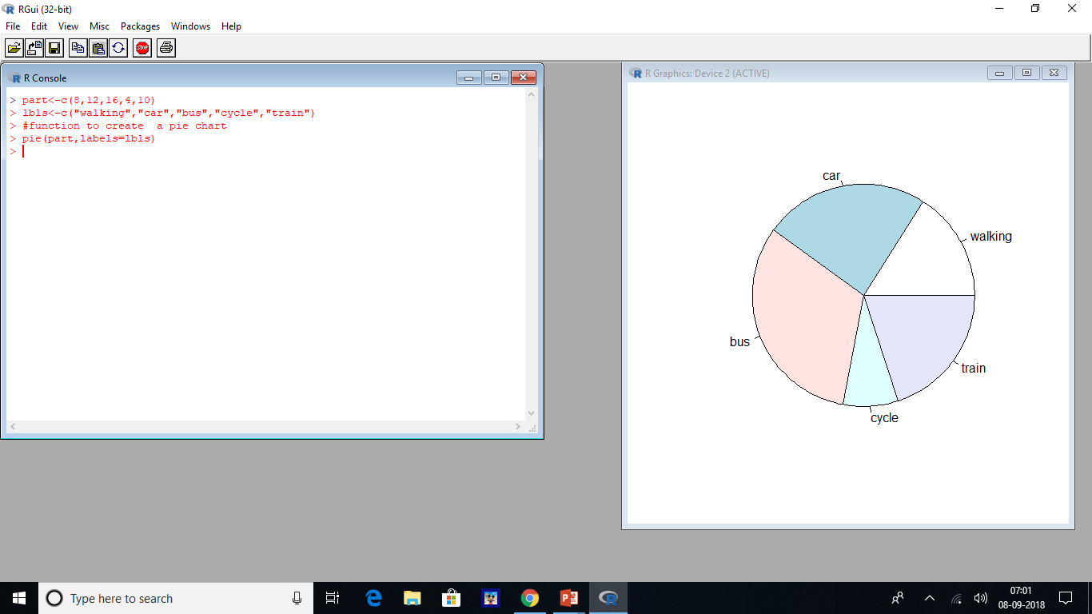
o/p:

Slide 7
Case b)considering the parameters part,labels,edges,radius, and main
i)numerical values 8,12,16,4,10 are assigned to a part argument and string values walking,car,bus,cycle and train are assigned to lbls argument
Ii)The title “Strategies utilized for travelling to office” is assigned using the main argument;the edge argument is used to change the values of the outer circle as 5
> part<-c(8,12,16,4,10)
> part
[1] 8 12 16 4 10
> lbls<-c("walking","car","bus","cycle","train")
> pie(part,labels=lbls,edges=5,main="Stragagies utilized for travelling to office")
#Commands and output for part,labels,edges,radius,and main

Slide 8
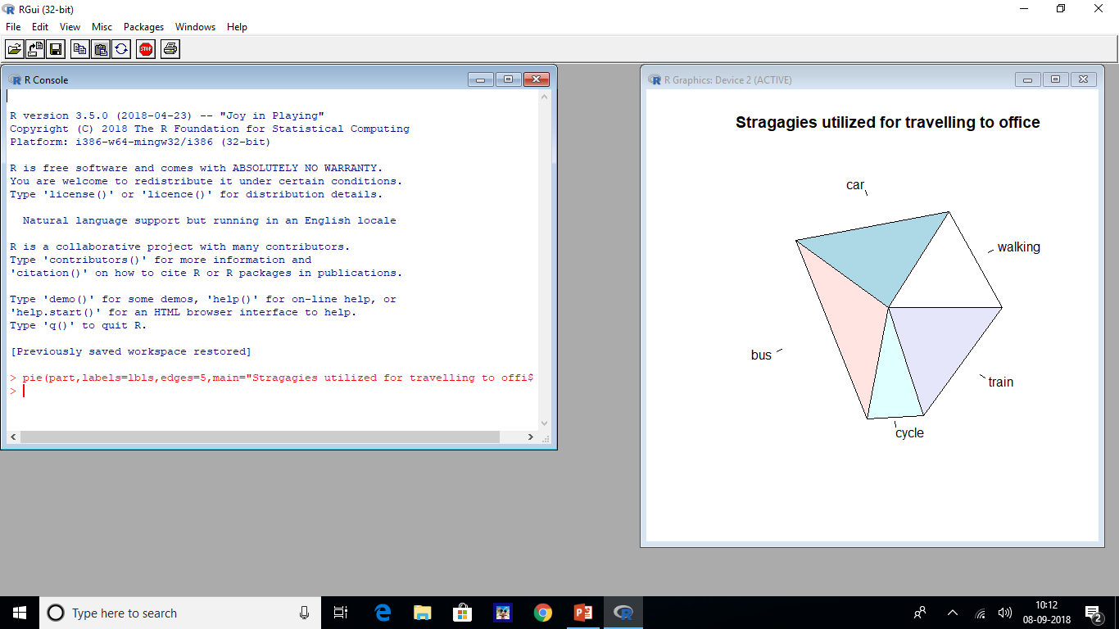

Slide 9
Case c)considering the parameters part,labels,radius and main
i)Numerical values 8,12,16,4,10 are assigned to a part argument and string values walking,car,bus,cycle,and train are assigned to lbls argument
ii)-1 is used to change the radius of the circle using the radius parameter ;the title “strategies utilized for traveling to office” is assigned using the main argument
> part<-c(8,12,16,4,10)
> part
[1] 8 12 16 4 10
> lbls<-c("walking","car","bus","cycle","train")
#commands and output for part,labels,radius and main

Slide 10
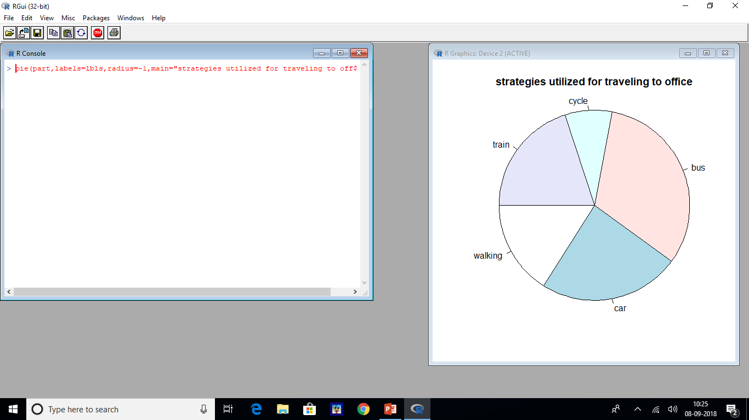

Slide 11
Case d)Considering the parameters part, labels, clockwise, and main
i)Numerical values 8,12,16,4,10 are assigned to a part argument and string values walking,car,bus,cycle, and train are assigned to lbls argument
ii)Boolean TRUE,FALSE value is assigned to the clockwise parameter to change the direction of the parts in the graph.ie., clockwise or counterwise;title:”strategies utilized for travelling to office” is assigned using the main argument
> pie(part,labels=lbls,clockwise=TRUE,main="strategies utilized for traveling to office")
#commands and output for part,labels,clockwise,and main

Slide 12
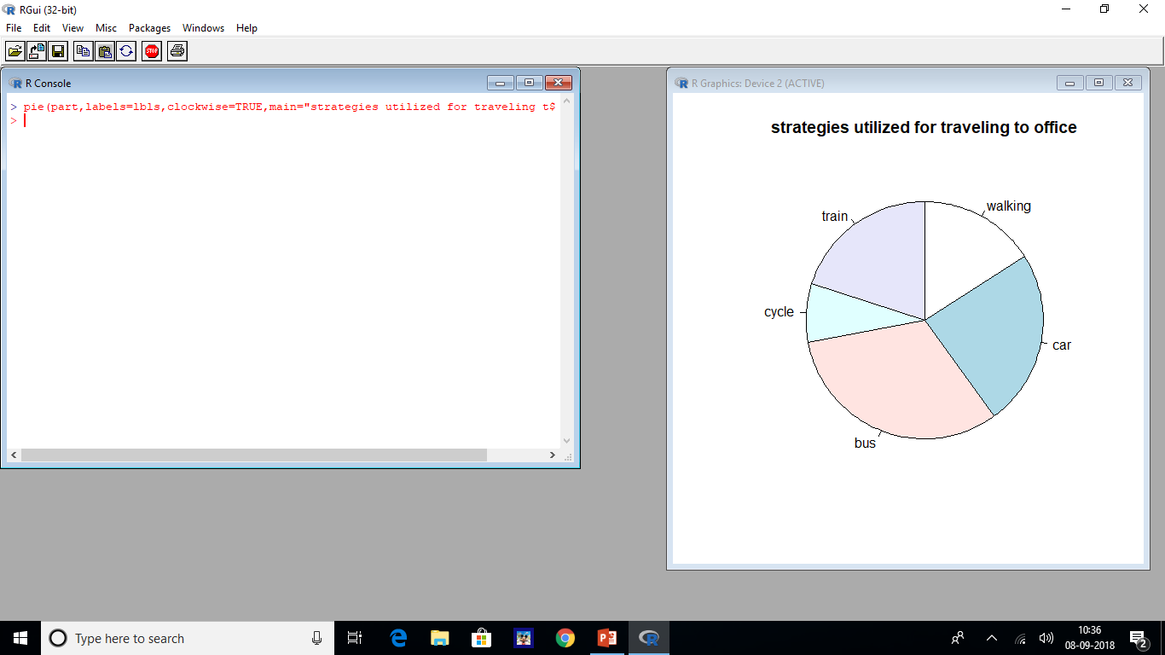

Slide 13
Case E)considering the parameters part,labels,density and main
i)The density parameter is used in this case to show lines inside the circle;if the value of density is high say 20, there will be more lines compared to say 5,as a density value as shown in fig:-
>pie(part,labels=lbls,density=20,main="strategies utilized for traveling to office")
#commands and output for part,labels,density and main

Slide 14
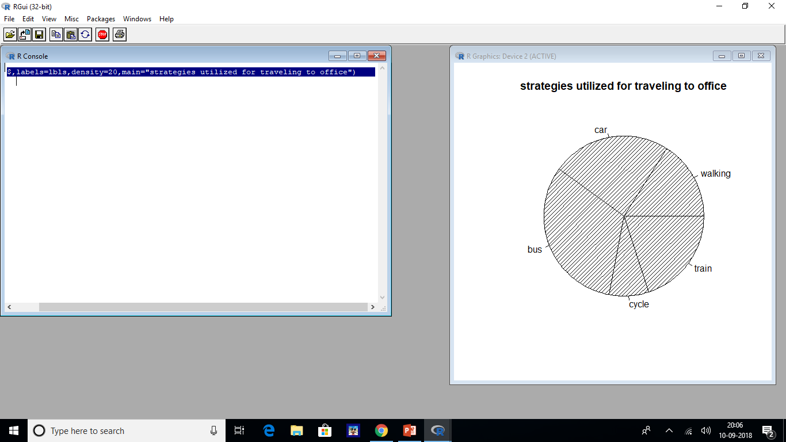

Slide 15
Case f)considering parameters part,labels,density,angle and main
i)The angle parameter is used in this case to assign an angle to each line inside the circle.
The value of the angle parameter is 90 and the lines are vertical
>pie(part,labels=lbls,density=20,angle=90,main="strategies utilized for traveling to office")
#commands and output for part,labels,density,angle and main

Slide 16
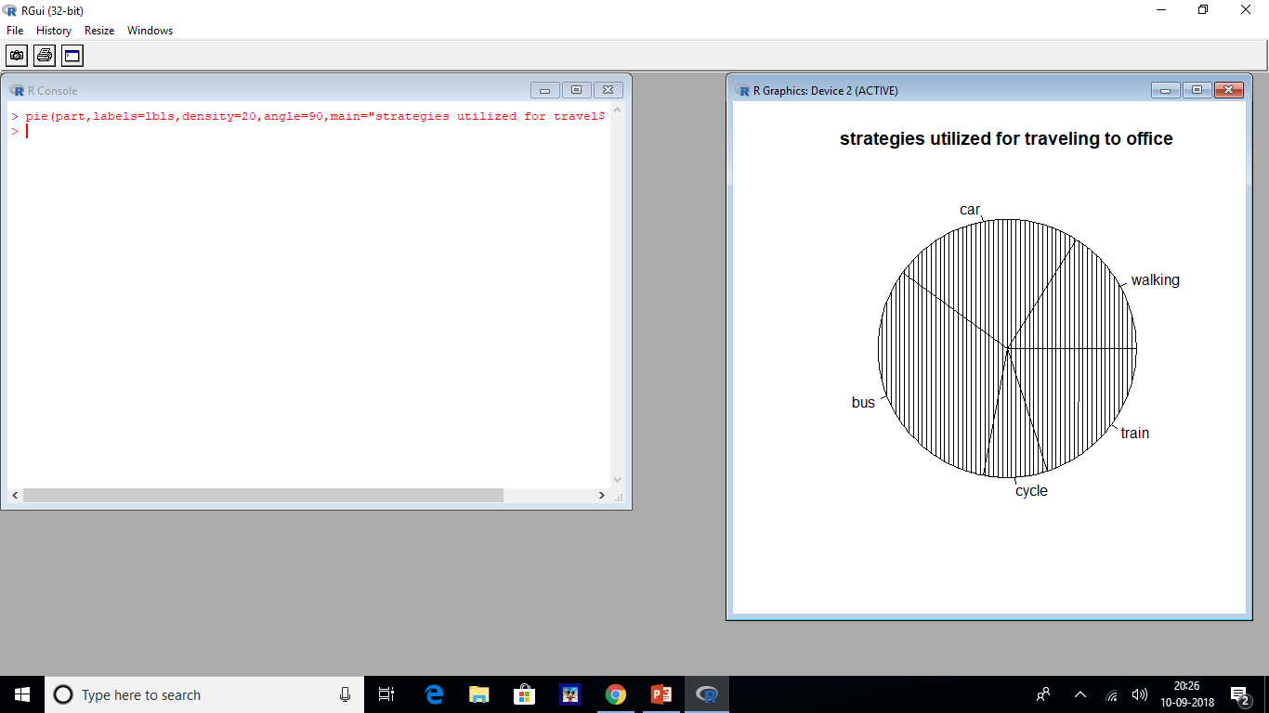

Slide 17
Case g) considering the parameters part,labels,col and main
i)The colors red,blue,green,yellow, and white are assigned to the col variable in this case
ii)The col parameter is used to fill color inside the parts of the circle
#commands and output for part,labels,col and main

Slide 18
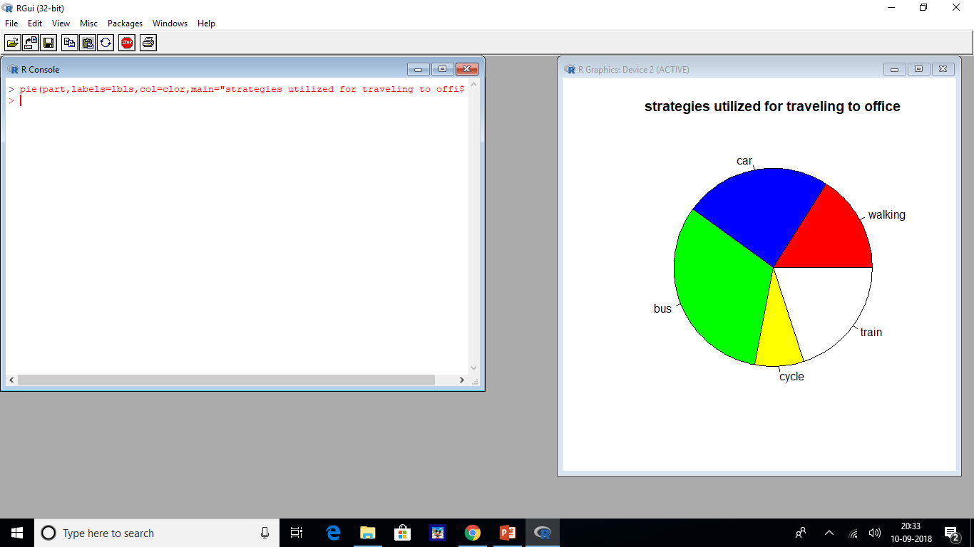

Slide 19
Case h) considering the parameters part,labels,border,col and main
A)The border parameter is used to change the circle border color, ie., each part of the circle in this case
B)red color is assigned to the border parmeter
> pie(part,labels=lbls,border="red",main="strategies utilized for traveling to office”)
#commands and output for part, labels,border,col and main

Slide 20
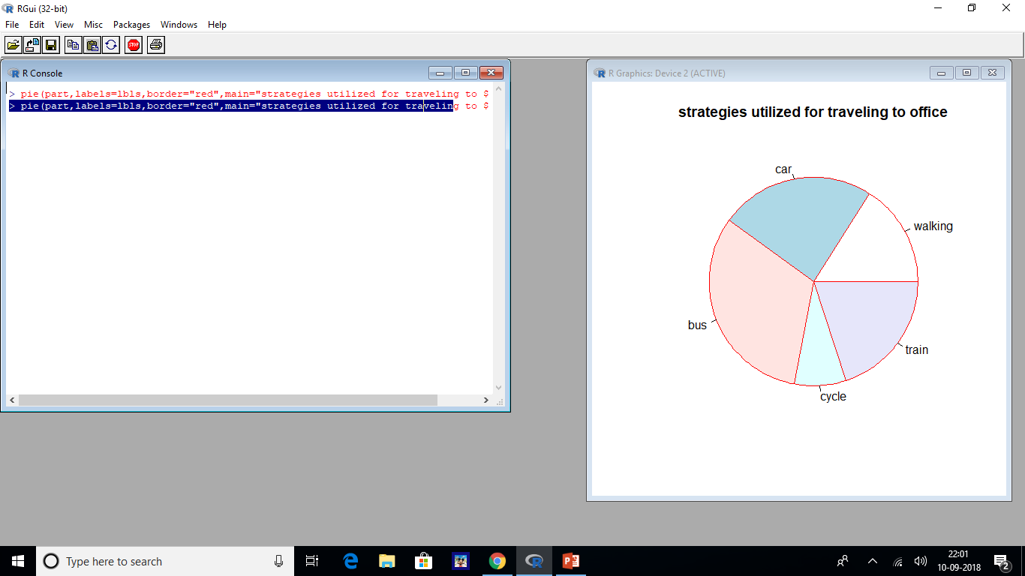

Slide 21
Chart legend
Chart legends are used to provide a small description of each part
We can specify whre on the chart it should be displayed ie., top-left,top-right,or bottom-right etc.,
In a pie chart the legend is included using the legend function.
Syntax:
Legend(position,labels,fill)
Position:states the position of legend
Labels:defines the label of blocks.
#eg:-using a chart legend, show the percentage conveyance of various ways for travelling to office such as walking,car,bus,cycle and train

Slide 22
i)Walking is assigned redcolor, car-blue color,bus-yellow color,cycle:greencolor and train-white color;all these values are assigned through cols and lbls variables and the legend function.
ii)The fill parameter is used to assign colors to the legend.
iii)Legend is added to the top-left side of the chart,by assigning the values as topleft;it can take different values such as topleft,bottomright,and bottomleft.
pie(part,labels=lbls,col=clor,main="strategies utilized for traveling to office")
>
#creating legend
> pie(part,labels=lbls,col=clor,main="strategies utilized for traveling to office")
> legend("topleft",fill=clor,c("walking","car","bus","cycle","train"))
> #strategies utilized for travelling to office
#Commands and output for legend

Slide 23
Commands and output for legend
> pie(part,labels=lbls,col=clor,main="strategies utilized for traveling to office")
> legend("topleft",fill=clor,c("walking","car","bus","cycle","train"))
>

Slide 24
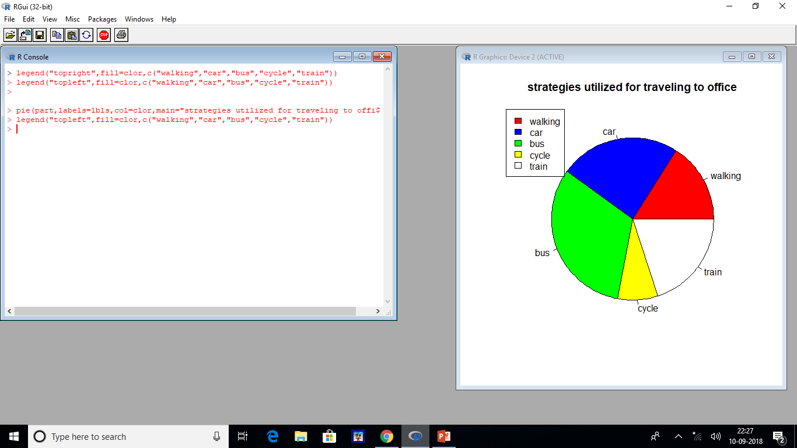

Slide 25
3D PIE CHART
A PIE CHART of 3 dimensional (3D) shape is called a 3D piechart.
It is used to display the information in 3D form.
A 3D piechart can be create using the pie3Dfunction
Syntax:-pie3D(parameters)
The pie3D() is used to create a 3D piechart, passing part,labels,main and radius as parameters.
> pie3D(part,labels=lbls,radius=-1,main="strategies utilized for travelling to office”)

Slide 26
BAR CHART
A bar chart represents data in rectangular bars with lengths relative to the value.
They are represented by 2 axis x---used to represent the groups
Y—used to represent the corresponding values.
R can draw both the vertical and level bars in the bar diagram.
In a bar chart each bar can be represented by a unique color:They are used to show the data related to finance,marketing and others.
Syntax:-
Barplot(part,names.arg,xlab,ylab,main,col)
Part:-contains a vector of non negative numeric values tells the size of parts
Main:used to display the title of the bar chart
Xlab:used to provide the label for the x-axis
Ylab:used to provide the label for the y-axis
Names.arg:used to display the label below each bar
Space:used to give space between each bar
Horiz:used to display the bar chart in vertical or horizon position takes Boolean values.

Slide 27
Density: used to show shading lines inside bars
Angle:used to assign the slope of shading lines inside bars
Col: used to assign colors like blue,red etc.,
Border:used to specify a color for the border
Sub: used to display the subtitle for th bar chart
Xlim:used to specify the limits for the x-axis example c(0,10)
Ylim:used to specify the limits for the y-axis example c(1,0)
Legend:list of arguments we want to add to the legend () function
Eg:-USING R bar chart demonstrate the % conveyance of various stratagies utilized for travelling to office such as bike,car,bus,auto and train
This problem can be demonstrated by taking some of the parameters of bar chart
Case a) considering the parameters part and main
i)numerical values 8,12,16,4,10 are assigned to a part argument
#commands and output for part and main

Slide 28
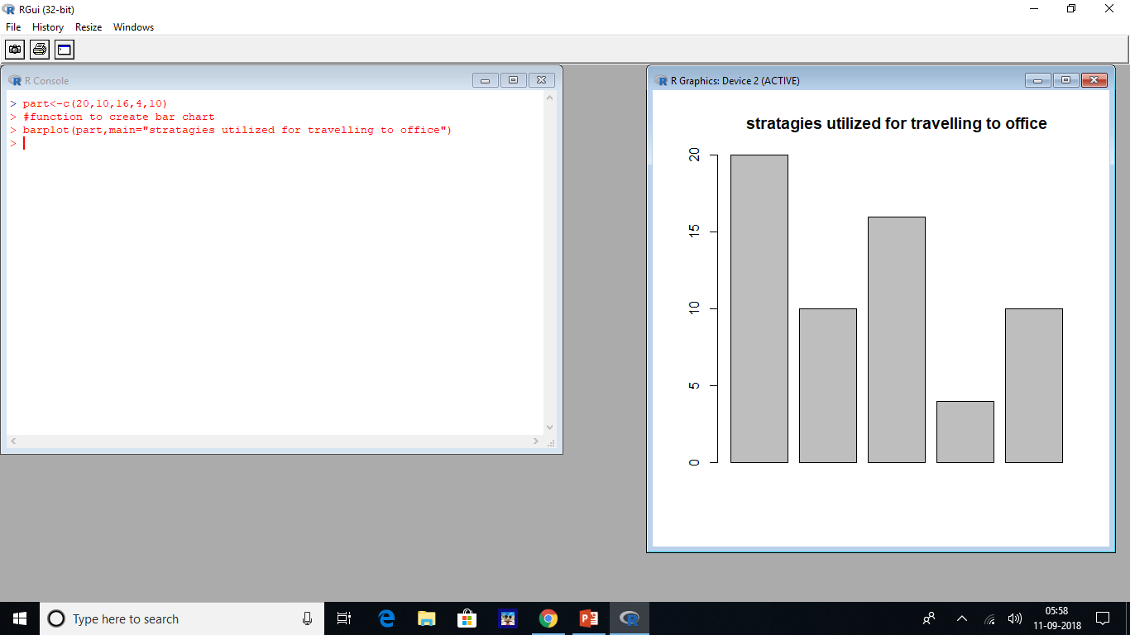

Slide 29
Case b)considering parameters part,main,xlab,ylab
> barplot(part,main="stratagies utilized for travelling to office",xlab="vehicles",ylab="numbers")

Slide 30
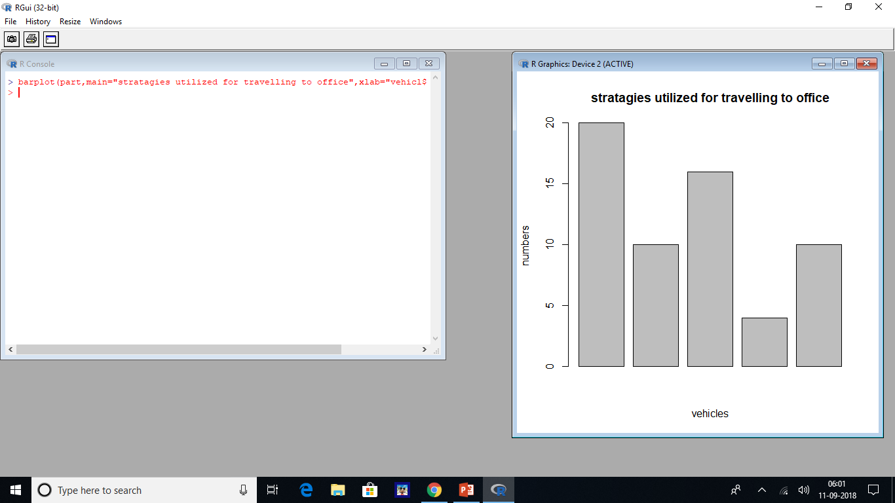

Slide 31
Case c)considering the parameters part,main,xlab,ylab and names.arg
> part<-c(20,10,16,4,10)
> lbls<-c("bike","car","bus","auto","train")
> barplot(part,main="stratagies utilized for travelling to office",xlab="vehicles",ylab="numbers",names.arg=lbls)
>

Slide 32
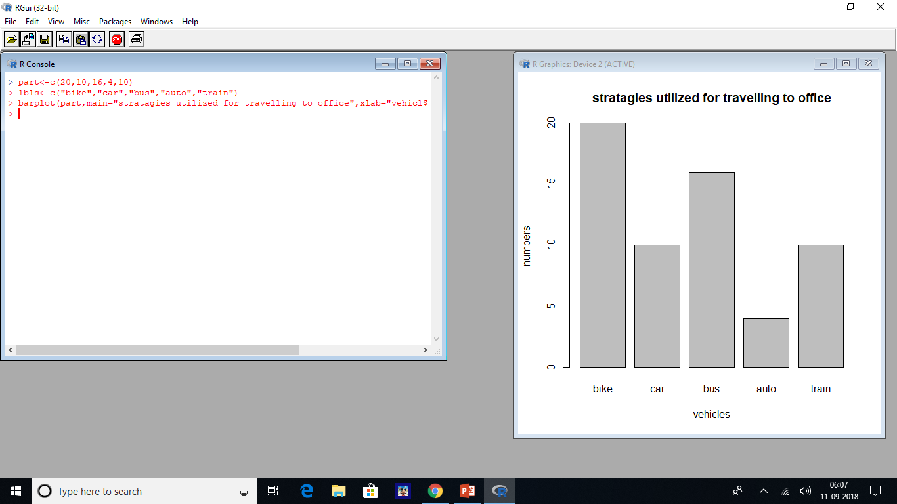

Slide 33
Case d) considering parameters part,main,xlab,ylab,names.arg,density and horiz
> barplot(part,main="stratagies utilized for travelling to office",xlab="vehicles",ylab="numbers",names.arg=lbls,density=10,
horiz=TRUE)
>

Slide 34
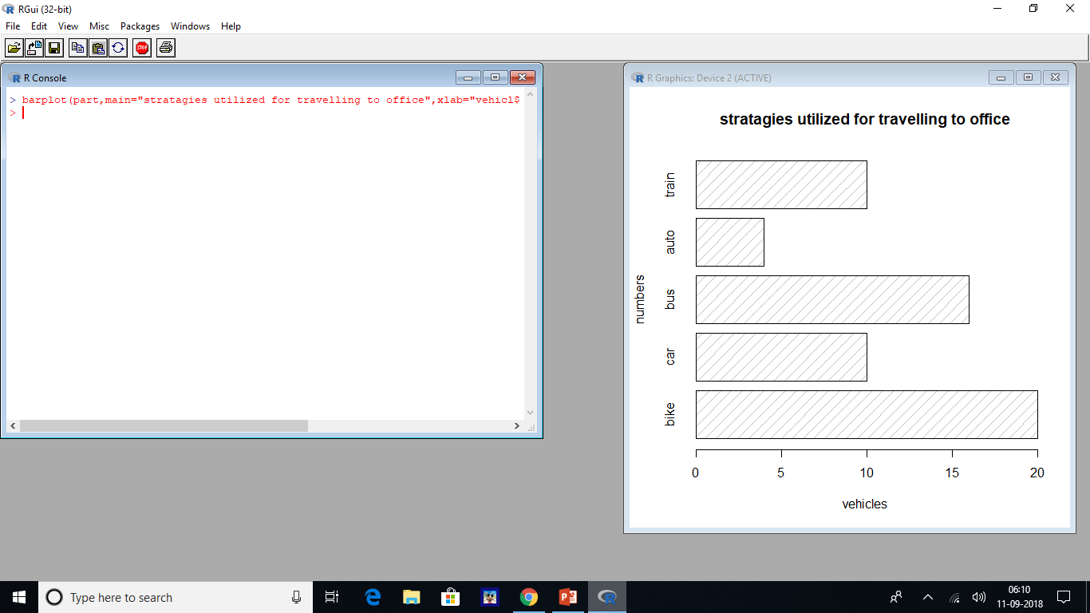

Slide 35
Case e) considering the color parameter
> part<-c(20,10,16,4,10)
> lbls<-c("bike","car","bus","auto","train")
> barplot(part,main="strategies utilized for travelling to office",xlab="vehicles",ylab="Numbers",names.arg=lbls,col=c("red",
"yellow","blue","black","white"))
>

Slide 36
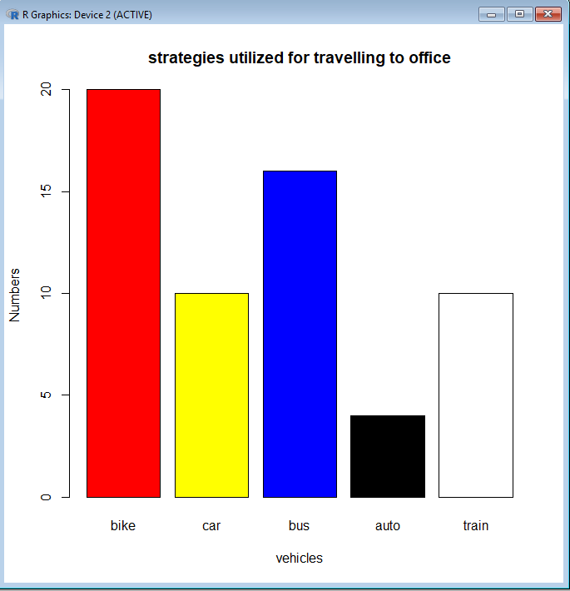

Slide 37
Case f) Considering the parameters density, angle and color
Density---display multiple lines inside each bar
Angle:-assign an angle to each line inside the bar .
> barplot(part,main="strategies utilized for travelling to office",xlab="vehicles",ylab="Numbers",names.arg=lbls, density=45, angle=45,col=c("red","yellow","blue","black","white"))

Slide 38
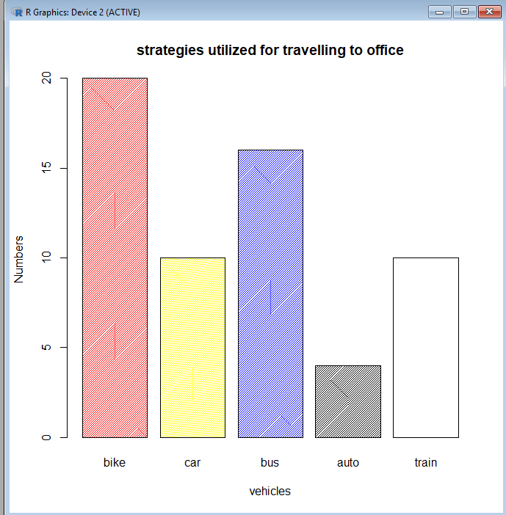

Slide 39
Case g)considering the parameters border and legend
i)border:assign black color to the border
Ii)bike---red car---yellow bus---blue auto---green train---pink
Fill: used to assign colors to the legend
Legends---add to top-right side of the chart
>barplot(part,main=“Strategies utilized for travelling to office”,xlab=“vehicles”,ylab=“Numbers”,border=“black”,col=c(“red”,”yellow”,”blue”,”green”,”pink”),names.arg=lbls),legend(“topright”,lbls,cex=.8,fill=c(“red”,”yellow”,”blue”,”green”,”pink”))

Slide 41
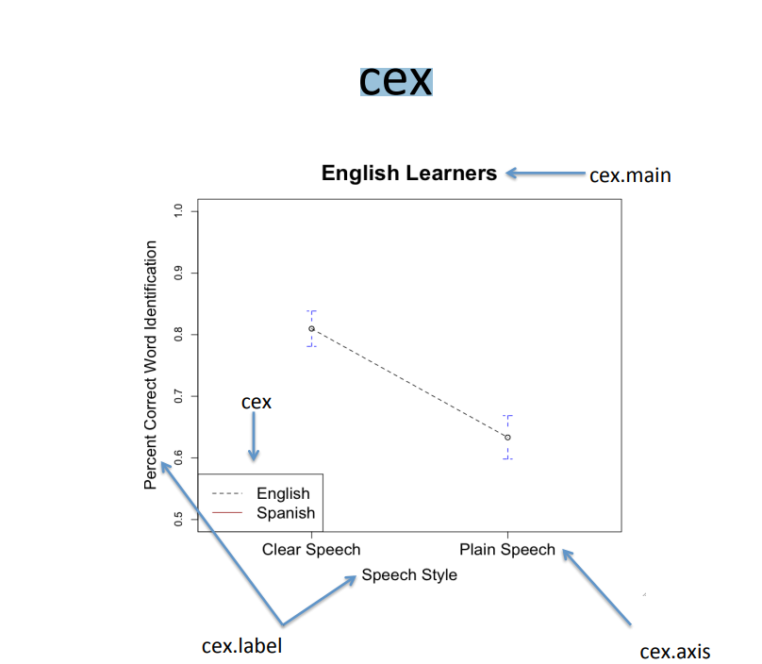

Slide 42
Case h)Designing a stacked bar plot using matrix values
i)The bar plot values are assigned through the matrix function of size 3x3
Ii)red,blue,yellow colors are assigned to the bars through col argument
> vec<-c(1,2,3,4,5,6,7,8,9)
> values<-matrix(vec,nrow=3,ncol=3)
> barplot(values,col=c("red","blue","yellow"))
> values
[,1] [,2] [,3]
[1,] 1 4 7
[2,] 2 5 8
[3,] 3 6 9
>

Slide 43
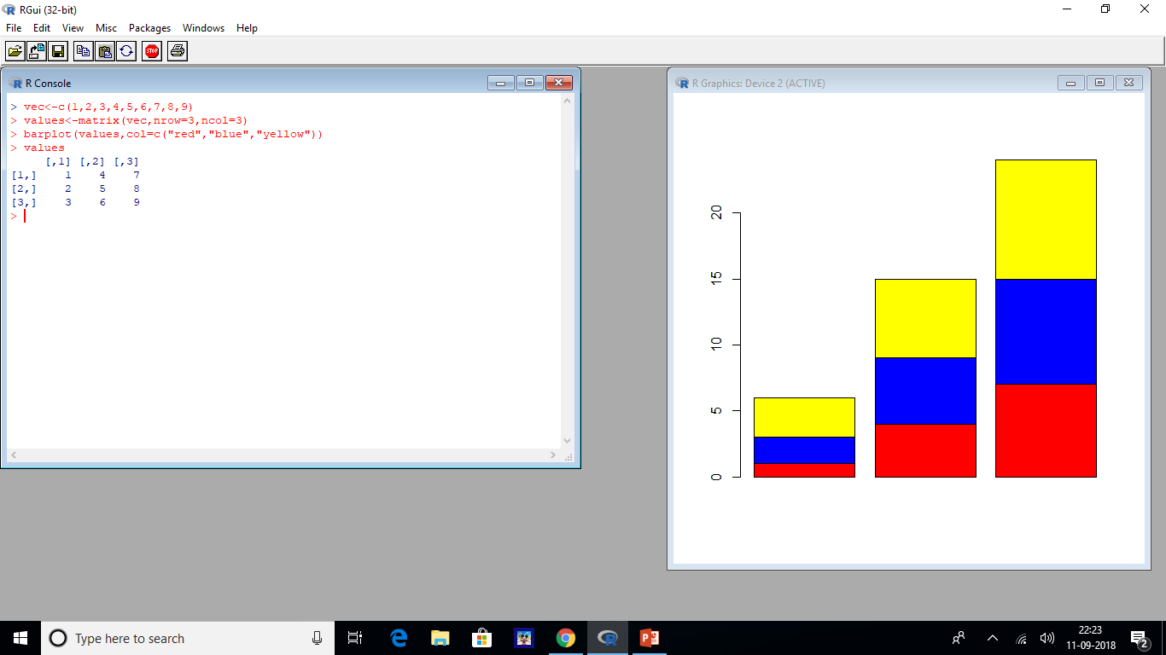

Slide 44
i)Designing a group bar plot using matrix values
i)The beside argument is used to create subgroups for the 3x3 matrix with red,blue,and yellow colors to create a group
> vec<-c(1,2,3,4,5,6,7,8,9)
> values<-matrix(vec,nrow=3,ncol=3)
> values
[,1] [,2] [,3]
[1,] 1 4 7
[2,] 2 5 8
[3,] 3 6 9
> barplot(values,col=c("red","blue","yellow"),beside=TRUE)
>

Slide 45
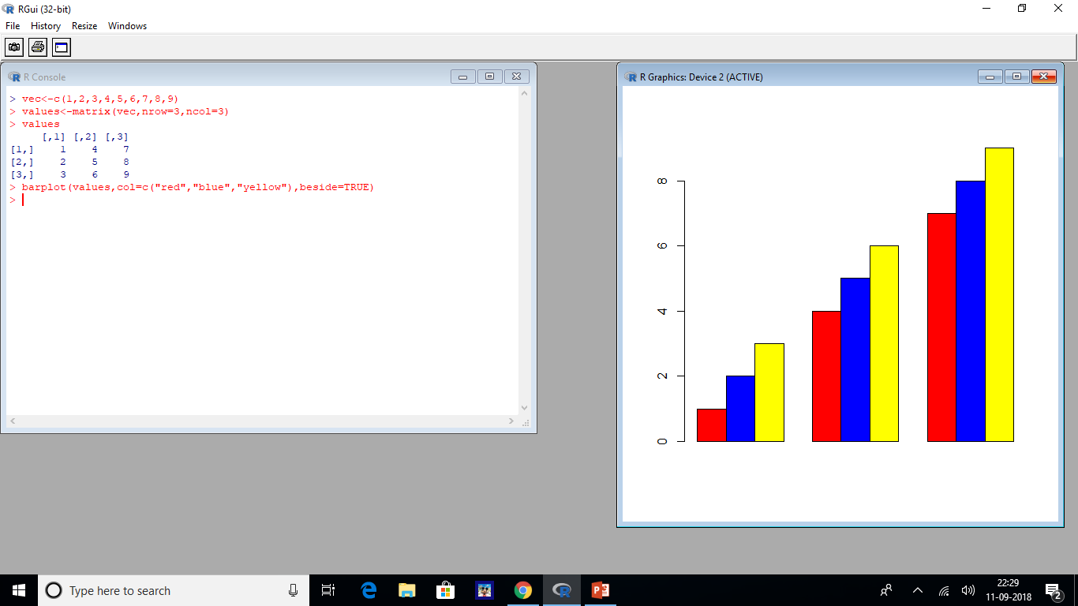

Slide 46
BOX PLOT
The box plot is a method to graphically picture the numerical information,gathered by particular information.
It gives a graphical perspective of the middle,quartiles,most and least extremes of an information set. Box plots can be designed using the boxplot() function.
Syntax:-
Boxplot(arguments)
There are various arguments in boxplot some of them are as follows:-
Data:contains a list of data to design a box plot
X:data or values to draw the boxplot
Xlab:label for x-axis
Ylab:label for y-axis
Main:title of the boxplot

Slide 47
Col:color to the boxplot
Notch:used to design a line on each side of the boxes;takes a Boolean value
Varwidth:a Boolean argument;if it is true boxes will be drawn with widths proportional to the square roots of the numbers of observations in the group
Border:-used to add color to the border of the boxplot
Subset:-used to limit the bar plots by providing a vector of values
Horizontal:a Boolean argument;if it is TRUE boxplot will be drawn horizontally ;if it FALSE ,the box plot will be drawn vertically
Eg:- consider inbuilt dataset of Rstudio called the Cars dataset
It gives the details related to car speeds and distances covered

Slide 48
> datasets::cars
speed dist
1 4 2
2 4 10
3 7 4
4 7 22
5 8 16
6 9 10
7 10 18
8 10 26
9 10 34
10 11 17
11 11 28
12 12 14
13 12 20
14 12 24
15 12 28
16 13 26
17 13 34
18 13 34
19 13 46
20 14 26

Slide 49
21 14 36
22 14 60
23 14 80
24 15 20
25 15 26
26 15 54
27 16 32
28 16 40
29 17 32
30 17 40
31 17 50
32 18 42
33 18 56
34 18 76
35 18 84
36 19 36
37 19 46
38 19 68
39 20 32
40 20 48
41 20 52
42 20 56
43 20 64
44 22 66
45 23 54
46 24 70
47 24 92
48 24 93
49 24 120
50 25 85
>

Slide 50
Eg:-using box plots demonstrate the relation between the cars speed and the distance taken to stop
We demonstrate this solutions by taking some of the parameters of box plots
Case a)considering the parameters data and x
i)The boxplot() is used to create a box chart
ii)We are displaying the speed and dist parameter of cars data set using x and data parameters as shown:
> boxplot(speed~dist,data=cars)

Slide 51
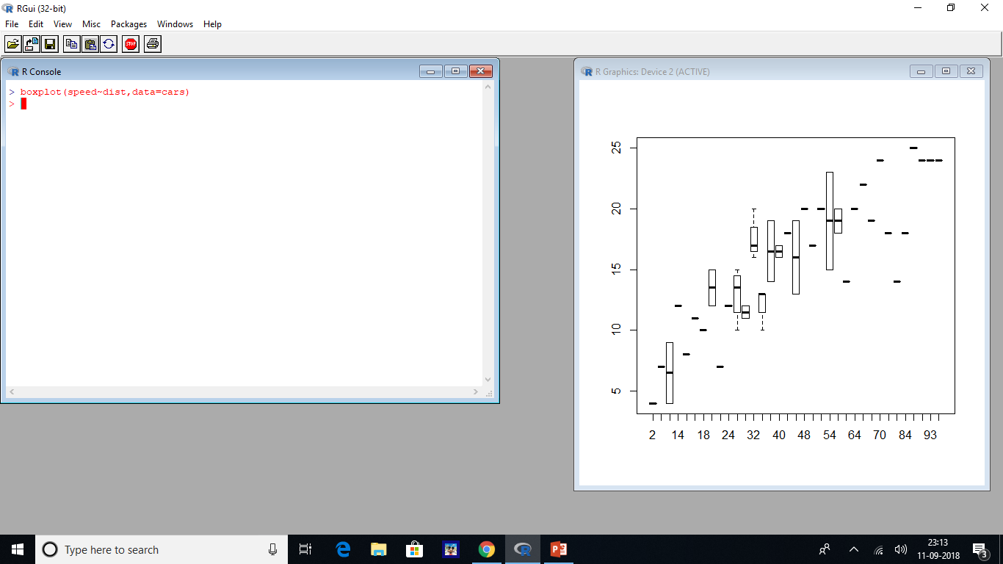

Slide 52
Case b)considering the parameters main,xlab,&ylab
> boxplot(speed~dist,data=cars)
> boxplot(speed~dist,data=cars,xlab="speed of cars:mph",ylab="Distance taken to stop:ft",main="cars dataset")
>

Slide 53
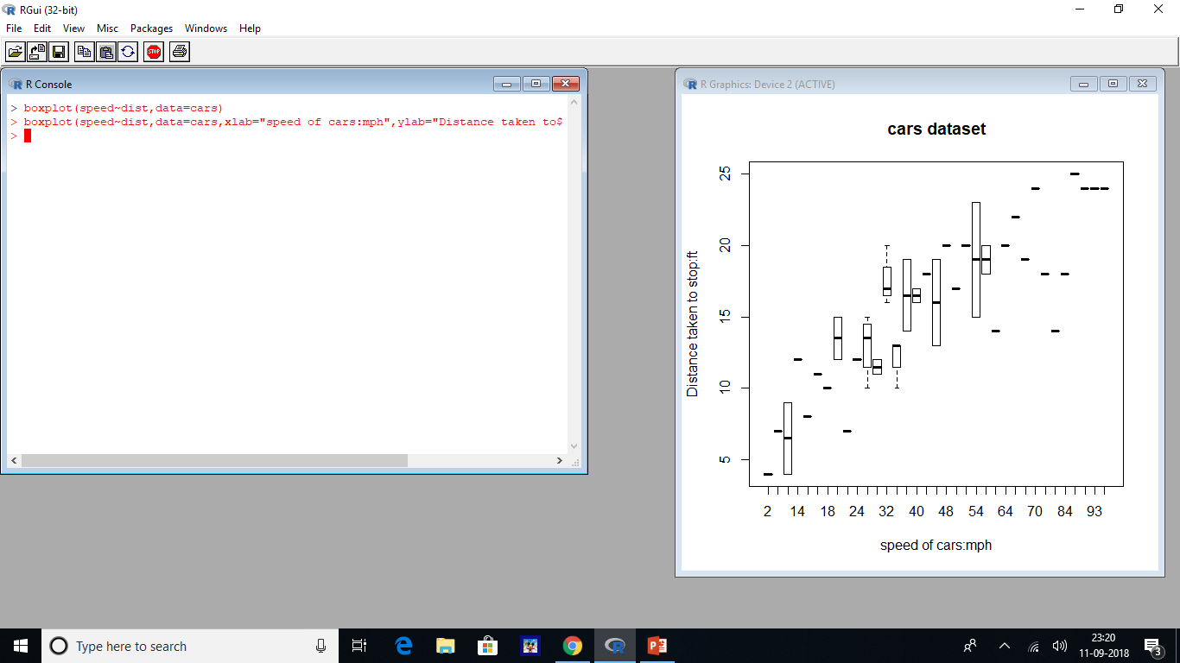

Slide 54
Case e)considering the parameters subset,data,main,xlab&ylab
Subset:-provides a limit to the bar chart
> boxplot(speed~dist,data=cars,xlab="speed of cars: mph",ylab="distance taken to stop:ft", main="cars dataset", col=c("green","red","blue"),c(2,14,18,24,32,40))
>
Or
> boxplot(speed~dist,data=cars,xlab="speed of cars: mph",ylab="distance taken to stop:ft", main="cars dataset", col=c("green","red"),border=“blue”,subset=c(2,14,18,24,32,40))

Slide 55
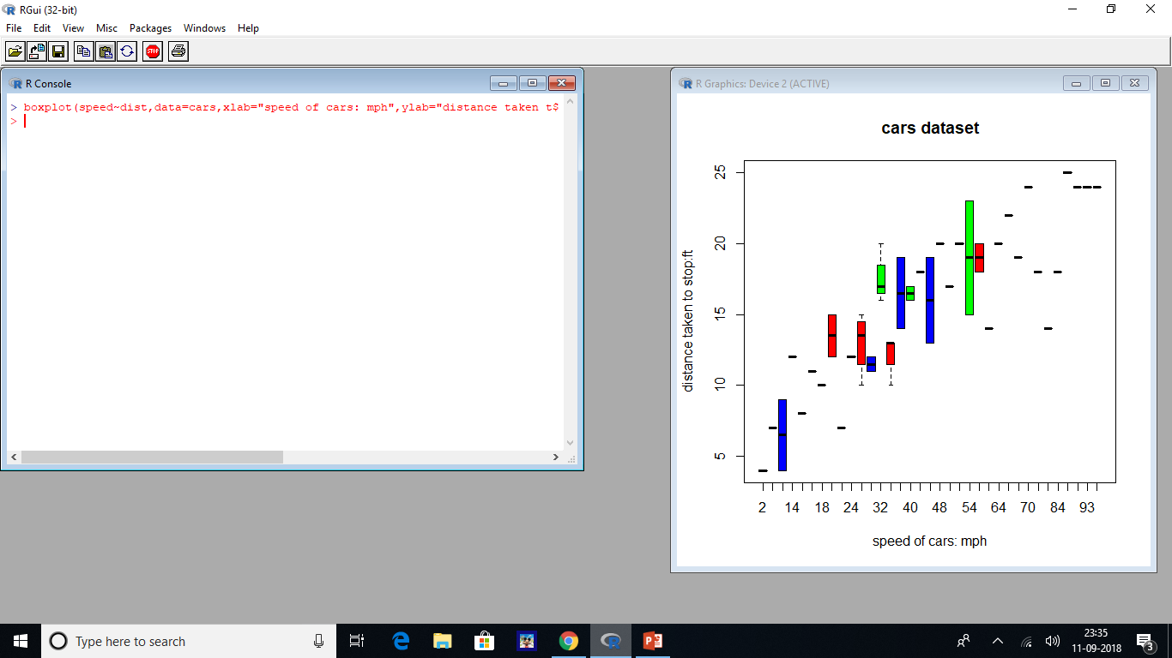

Slide 56
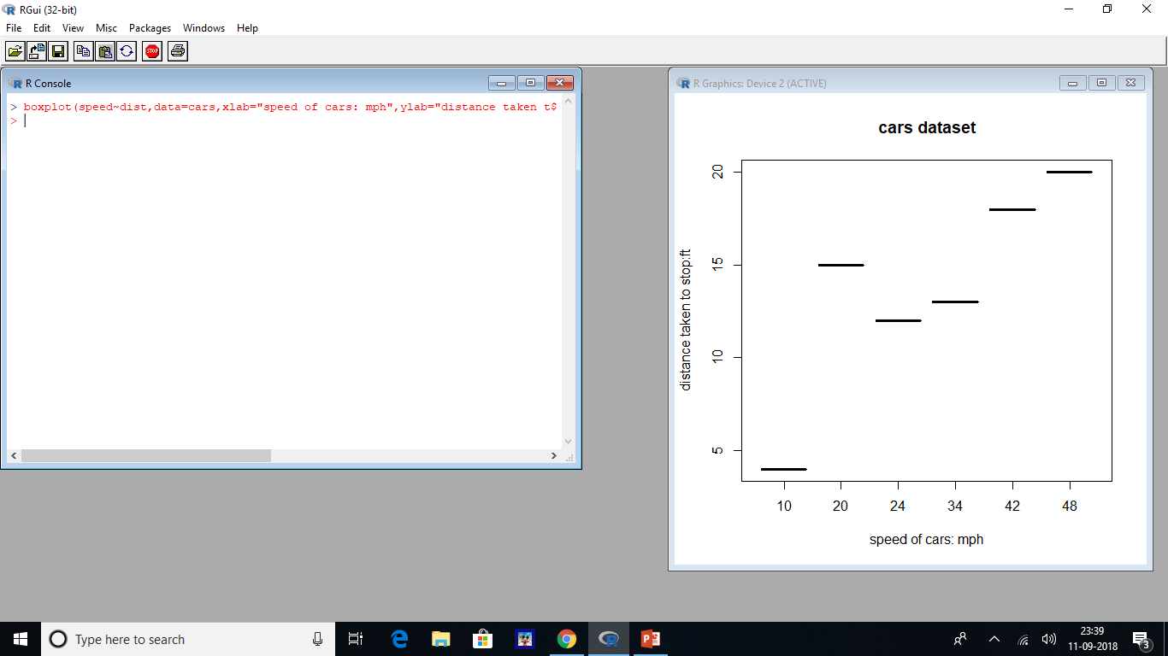

Slide 57
Case f) considering the horizontal boxplot for the given dataset
> boxplot(speed~dist,data=cars,xlab="speed of cars: mph",ylab="distance taken to stop:ft", main="cars dataset", col=c("green","red"), horizontal=TRUE)

Slide 58
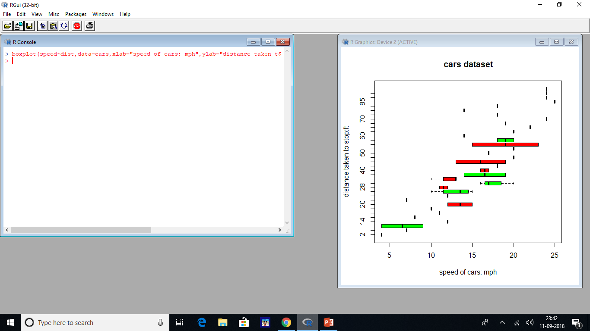

Slide 59
HISTOGRAM
A histogram is a plot that gives us a chance to find and show the hidden recurrence of a set of continuous information.
There is no gap between the bars as it represents continuous data.
Each bar in the histogram shows the values present in that image
Syntax: hist(arguments)
List of arguments used:
Data:values to create a histogram
Main:title of the histogram
Col:provides color for blocks
Xlab:label for x-axis
Ylab:label for y-axis
Labels:used to display the values of the blocks at the top;takes a Boolean value
Xlim:used to display values till a specific limit on the x-axis takes (x1,x2) as input values where x1 and x2 are numbers

Slide 60
Ylim:used to display values till a specific limit on the y-axis ;takes (y1,y2)as input value where y1 and y2 are numbers.
Density: used to create a shaded line inside the block
Breaks:used to specify the width of blocks or to break the histogram
Angle:used to provide a slope of shaded line inside blocks.
#construct the histogram for the cars dataset
Using R histogram to show the relationship b/w the cars speed and distance taken to stop
Case a) Considering the parameters data,main and col
i)hsit() is used
ii)input is:cars$speed
iii)main=“Cars dataset”
Assign colors using col argument
> hist(cars$speed,main="cars dataset",col=c("red","yellow","blue","purple","brown"))

Slide 61
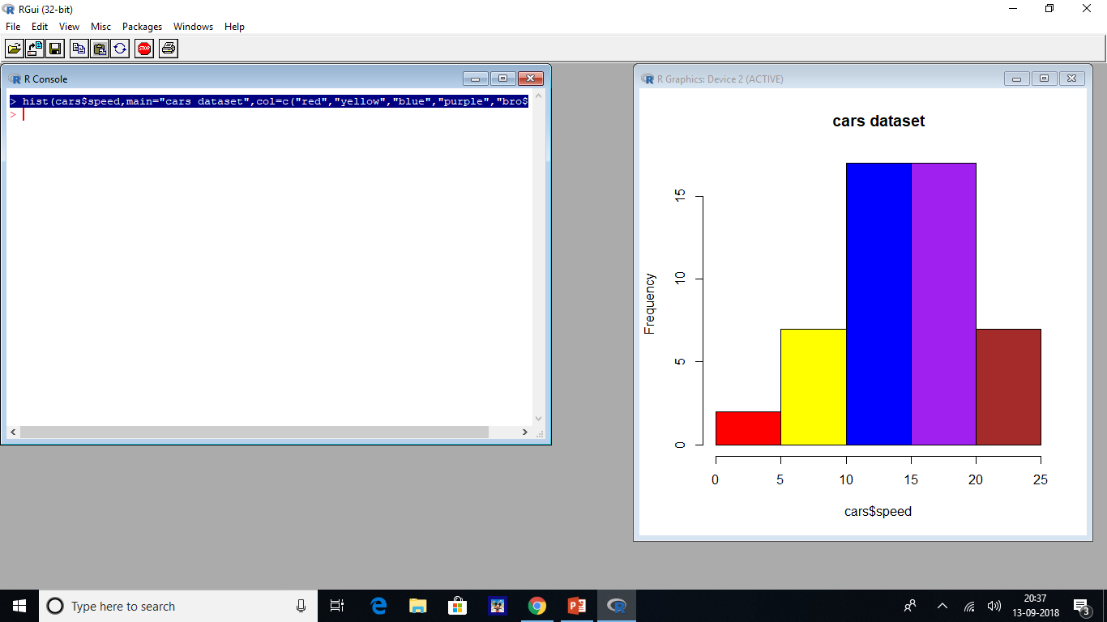

Slide 62
Caseb) considering the parameters xlab,border,data,main and col
Xlab:”cars speed:mph”
Border=blue
Col argument=c(white,yellow)
> hist(cars$speed,main="cars dataset",xlab="car speed:mph",col=c("white","yellow"),border="blue")

Slide 63
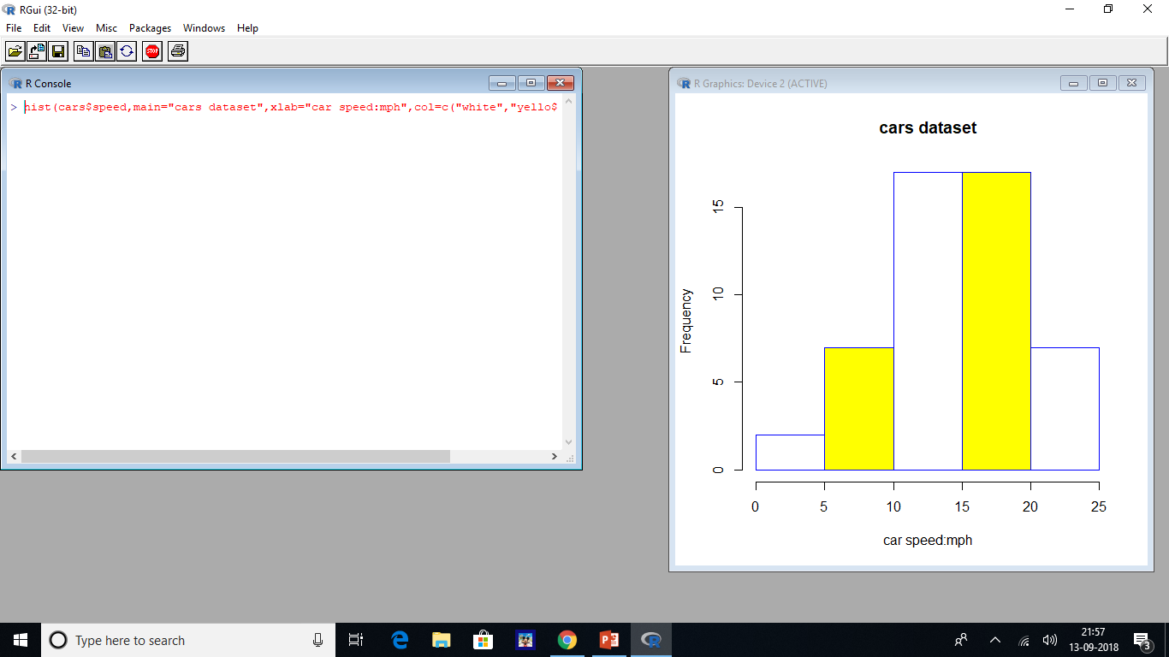

Slide 64
Case c) considering the parameters xlim,ylim,and label
i)xlim,ylim parameters
ii)xlim=c(0,15) will display the portion of x-axis ie., b/w 0 and 15
Iii)ylim=c(0,30)will display the portion of y-axis ie., b/w 0 and 30
Labels=true
> hist(cars$speed,main="cars dataset",xlab="car speed:mph",col=c("red","yellow"),border="blue",labels="TRUE",xlim=c(10,15),ylim=c(0,30))

Slide 65
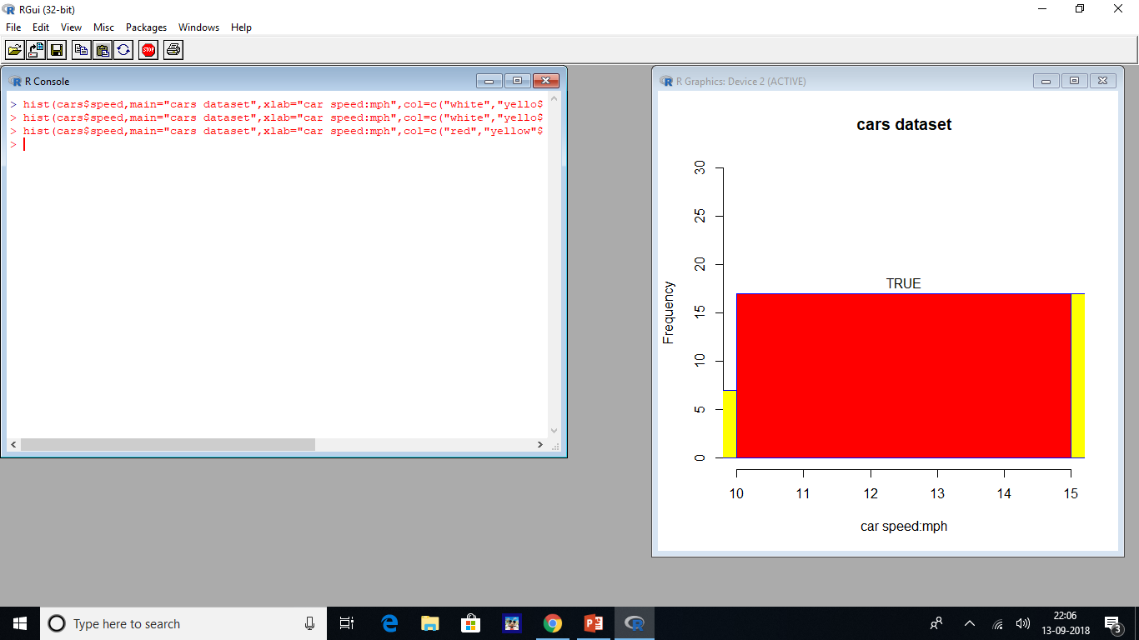

Slide 66
Case d)considering the parameters density,break,and angle
i)The value of density =20;creates multiple lines inside each block
ii)angle:used to give a particular angle to the vertical lines that are present inside each block.angle=90 degrees
> hist(cars$speed,main="cars dataset", xlab="car speed:mph",col=c("red","green"),border="blue",ylim=c(0,20),labels=TRUE,density=20,breaks=10,angle=90)

Slide 67
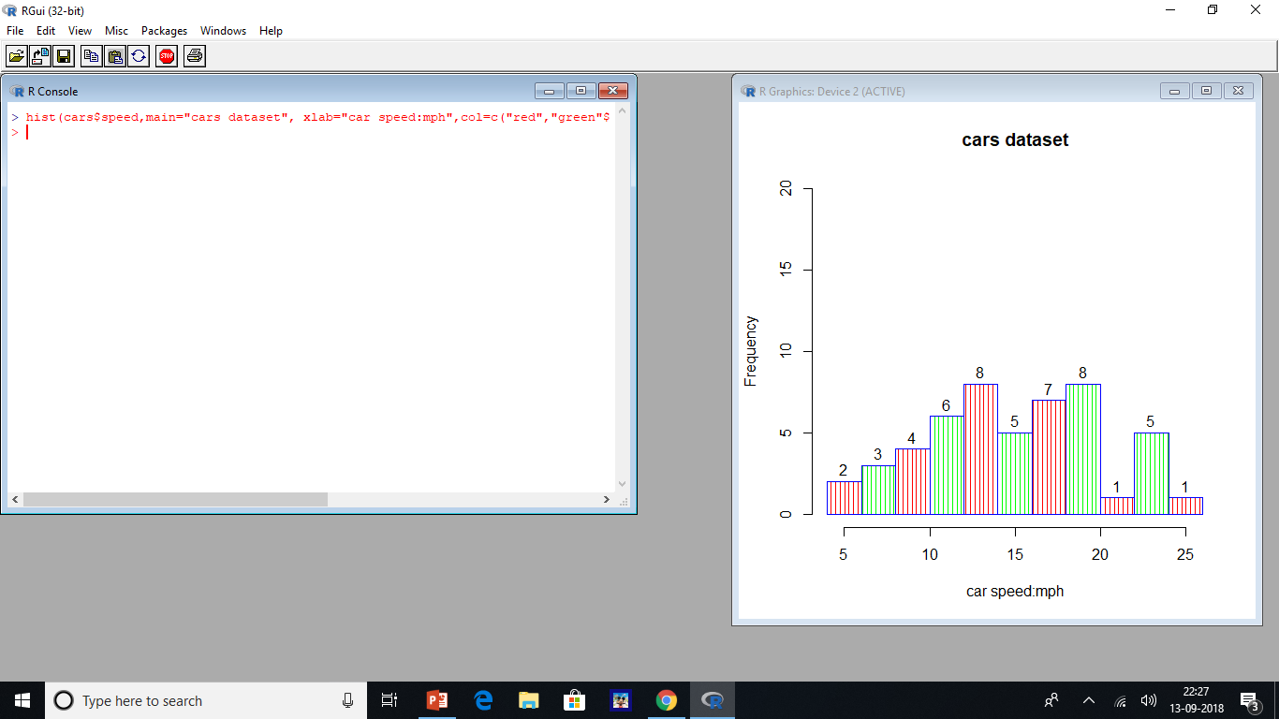

Slide 68
Case e)designing a density curve
i)A curve line is provided to the histogram using the density curve argument ;use line function and density argument to create a curve for the cars dataset
> hist(cars$speed,main="Cars Dataset", xlab="car speed:mph",col=c("red","green"), las=1, xlim=c(0,30),ylim=c(0,0.07))
> lines(density(cars$speed))
>

Slide 69
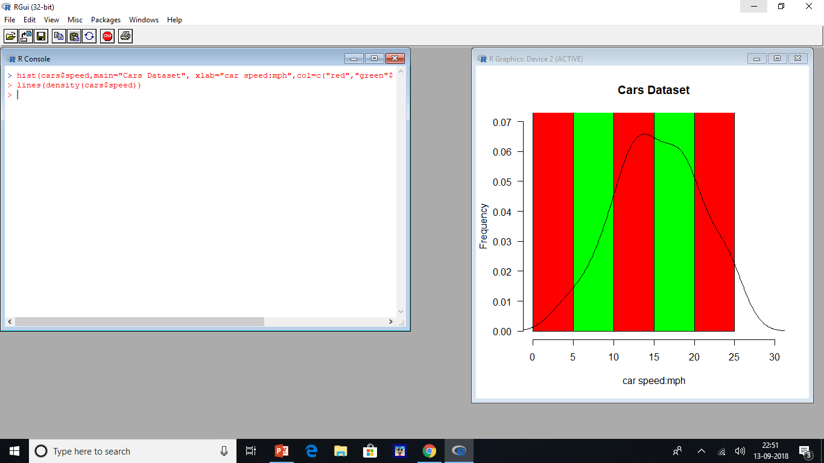

Slide 70
Case f) combining multiple histograms
i)Two different histograms are combined by taking values of the inbuilt dataset ie., cars and in the next one we are assigning a value to the variable d
ii)2 different functions are called to create histograms—one for the cars dataset and another one for d variable values
iii)car dataset values are displayed in greencolor and d values are displayed in blue color
> datasets::cars
> d<-c(12,6,15,0,4,3,10,4,3,2,12,3,6,7,3,4,1,2,1,5,2)
> hist(cars$speed,main="cars dataset",type="1",xlab="cars speed:mph",ylab="Distance covered to stop car:ft",col="green")
> hist(d,col="blue",add=T)

Slide 71
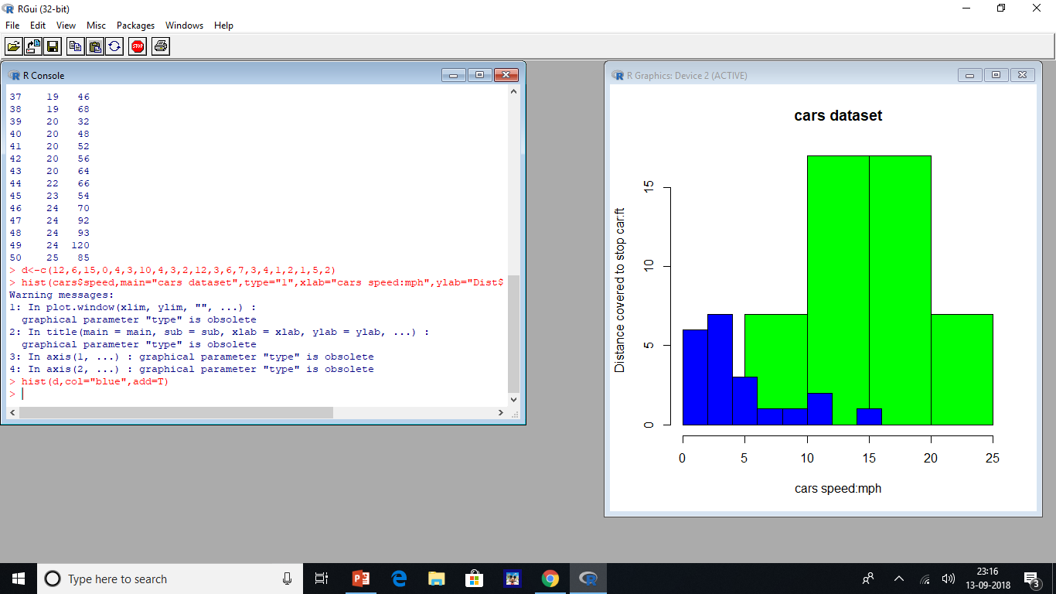

Slide 72
LINE GRAPH
Line graph used to show information as a sequence of data,which are linked through a straight line
It is made up of a horizontal x-axis and vertical y-axis .
Line graphs are mainly used to display information related to marketing,weather reports,finance and other areas.
To create a line graph we use the plot().
Syntax:=plot(arguments)
List of arguments are:-
Data:numeric values used to create the graph
Type:used to show lines in different forms as follows:
1:show only line h:show line in vertical format
P:show only points s or S :show line in square wave format(top-down or bottom up
O:show both points and line main:title ofline graph col:used to assign color to graph

Slide 73
Main:title of line graph
Col:used to assign color to graph
Xlab:used to label x-axis
Ylab:label y-axis
#using R line graphs demonstrate the relationship between cars speed and the distance taken to stop
Case a)considering the parameters data and main
> datasets::cars
> plot(cars,main="cardataset")

Slide 74
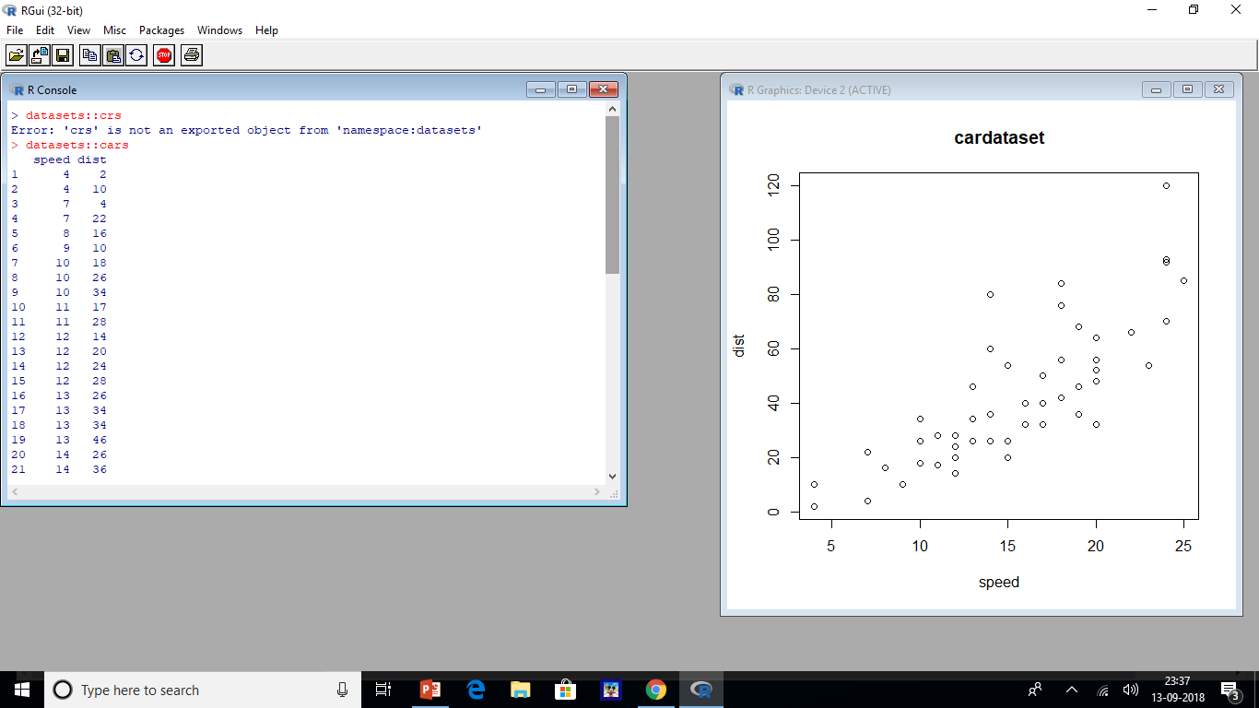

Slide 75
Case b) considering the parameters data, type=p,main,xlab,ylab
i) > plot(cars,main="carsdataset", type="p", xlab="cars speed:mph", ylab="distance covered to stop car:ft")
>

Slide 76
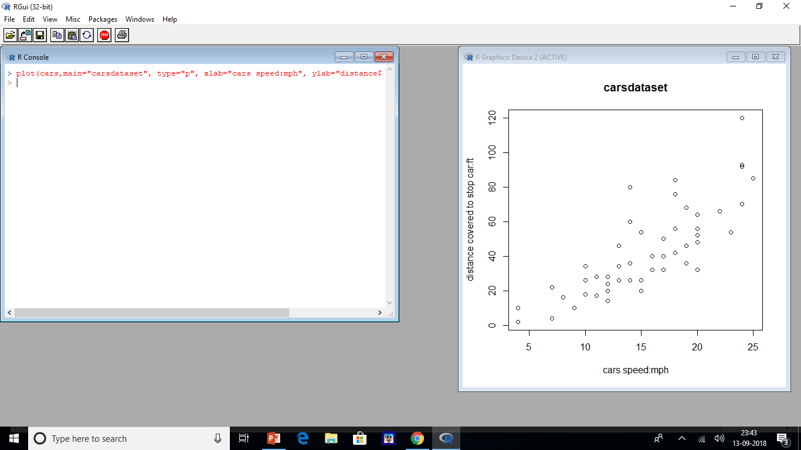

Slide 77
Case c)considering parameters data,type=0,xlab,ylan and main
Type=0; used to create a line graph that shows both the points and line
> plot(cars,main="carsdataset", type="o", xlab="cars speed:mph", ylab="distance covered to stop car:ft")

Slide 78
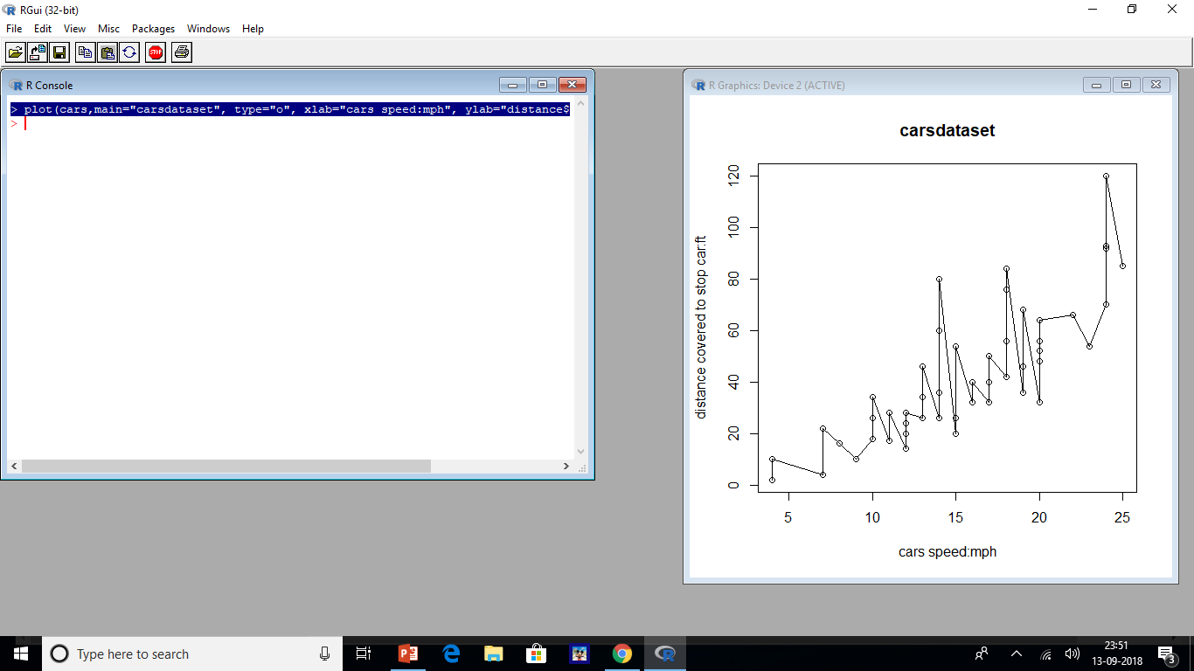

Slide 79
Case d)considering the parameters data,type=1,col,main,xlab,ylab
Type=1 used to create a line graph that shows only the line
> plot(cars,main="carsdataset", type="l", xlab="cars speed:mph", ylab="distance covered to stop car:ft",col="blue")
>

Slide 80
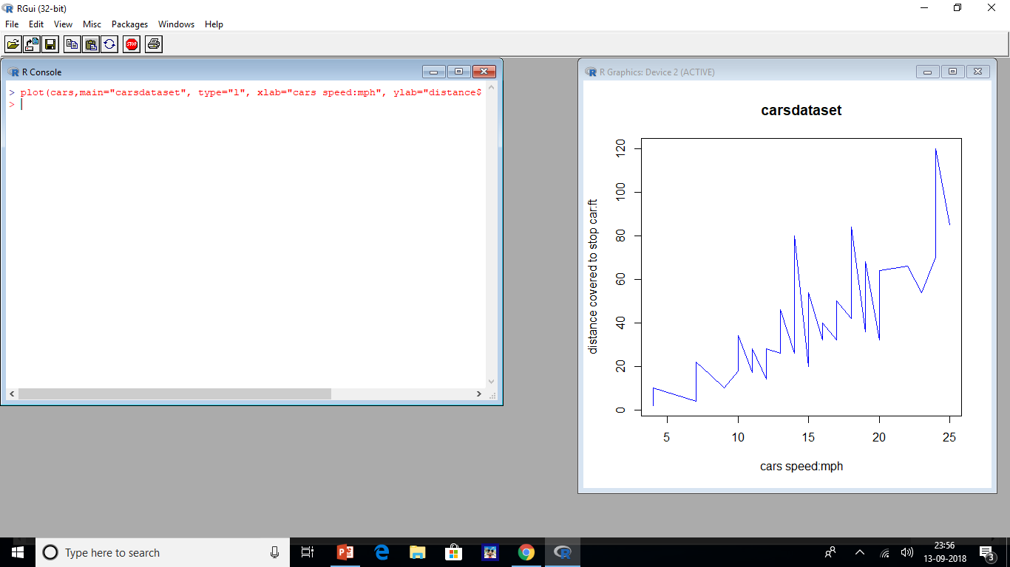

Slide 81
Case e)considering the parameters data,type=s col,main,xlab,ylab
Line graph is created in the form of stairs when type=s
> plot(cars,main="carsdataset", type="s", xlab="cars speed:mph", ylab="distance covered to stop car:ft",col="red")
>

Slide 82
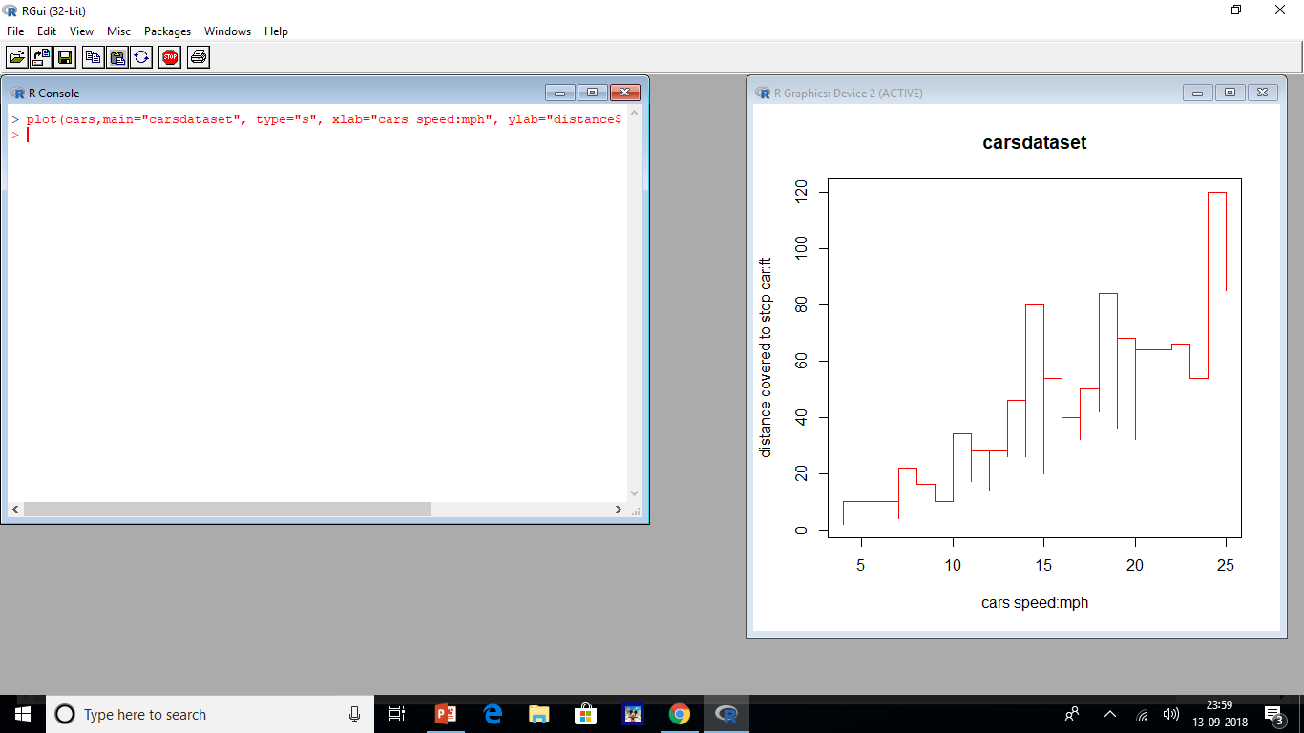

Slide 83
Case f)considering the parameters data,type=h,col,main,xlab and ylab
If type=h then line graph is plotted in vertical form
> plot(cars,main="carsdataset", type="h", xlab="cars speed:mph", ylab="distance covered to stop car:ft",col="green")
>

Slide 84
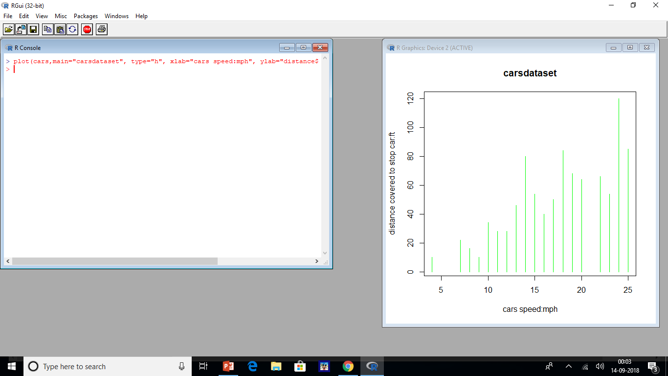

Slide 85
Multiple lines in Line graph
Multiple lines graphs can be created in R
2 different values to demonstrate multiple lines in line graphs
One graph:taken from dataset; second graph: assigning values to variable d
>datasets::cars
> d<-c(12,6,15,20,34,33,10,44,3,2,12,33,56,7,23,4,31,22,21,56,32)
> plot(cars,main="carsdataset", type="l", xlab="cars speed:mph", ylab="distance covered to stop car:ft",col="green")
> lines(d,type="o",col="blue")
>

Slide 86
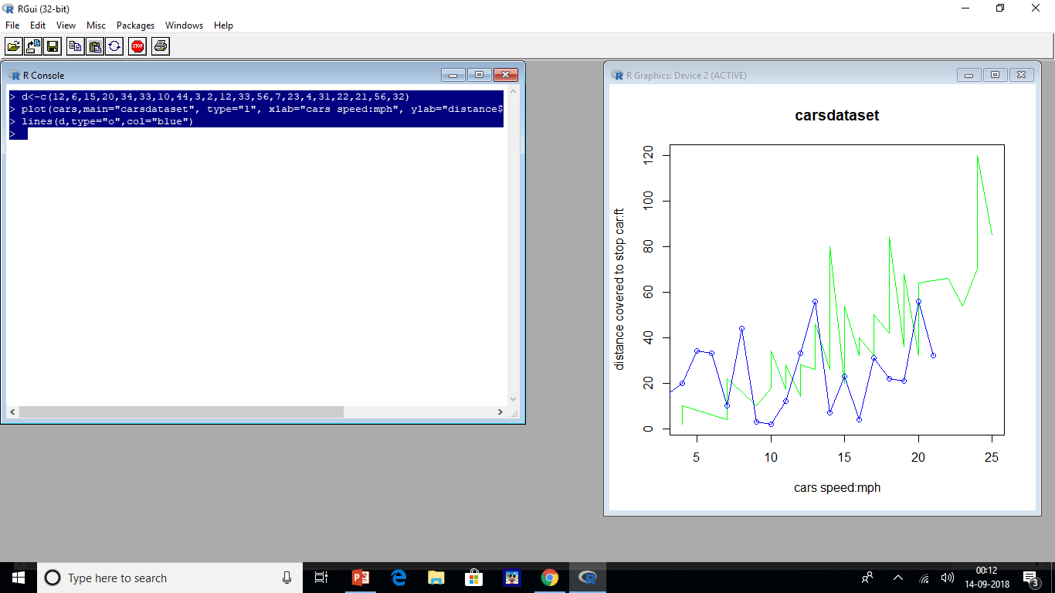

Slide 87
SCATTER PLOT
Scatter plot are used to show the relation between 2 variables of the given sets of data.
Data are displayed as a group of points inthese plots.
They can be used when one of the two variables are both independent or dependent of each other
Scatterplots are usally used to display information related to marketing ,finance etc.,

Slide 88
Syntax: plot(arguments)
X:data for x-axis
Y:data for y-axis
Main:title
Type: p:to show values as points o:to show values as overplotted
l:to show values as a line h: generates histogram
S:show squarewaves
Sub:display subtitle
Col:assign colors
Frame.plot:used to draw a box around the scatter plot
asp:aspect ratio of the scatter plot
Xlab:label for x-axis ylab:label for y-axis xlim:assign limit for x-axis ylim:assign limit for y-axis axes: used to draw axis;take a booleanvalue

Slide 89
Eg:-using scatter plots in R demonstrate the relationship b/w cars speed and the distance taken to stop it
This problem is demonstrated by taking some of the parameters of scatter plot
Case a)considering the parameters x,y,sub and main
i)plot() creates a scatter plot using 2 arguments x—used to pass car speed and y—used to pass cars distance
ii) use dollar symbol to extract the data from the cars dataset
iii) The sub argument is used to assign the subtitle:”data to the graph”
Iv)The main argument is used to assign the title “cars dataset” to the scatter plot
> plot(x=cars$speed,y=cars$dist,main="cars dataset",sub=data)

Slide 90
> datasets::cars
speed dist
1 4 2
2 4 10
3 7 4
4 7 22
5 8 16
6 9 10
7 10 18
8 10 26
9 10 34
10 11 17
11 11 28
12 12 14
13 12 20
14 12 24
15 12 28
16 13 26
17 13 34
18 13 34
19 13 46
20 14 26

Slide 91
21 14 36
22 14 60
23 14 80
24 15 20
25 15 26
26 15 54
27 16 32
28 16 40
29 17 32
30 17 40
31 17 50
32 18 42
33 18 56
34 18 76
35 18 84
36 19 36
37 19 46
38 19 68
39 20 32
40 20 48
41 20 52
42 20 56
43 20 64
44 22 66
45 23 54
46 24 70
47 24 92
48 24 93
49 24 120
50 25 85

Slide 92
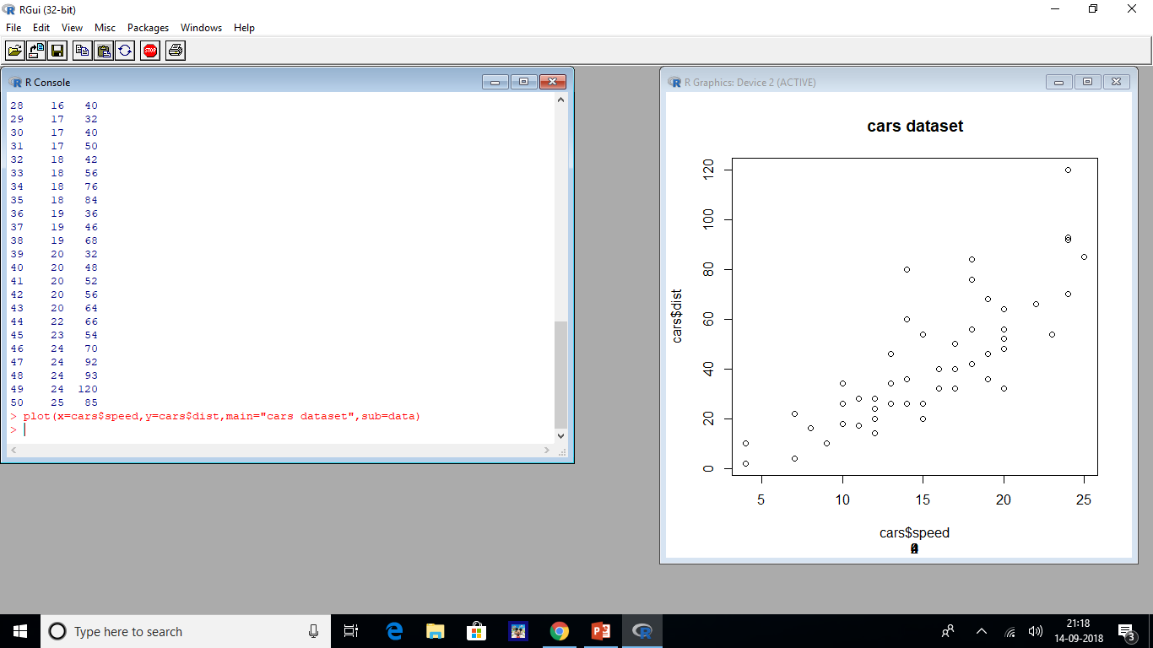

Slide 93
Case b)considering the parameters col,frame.plot,x,y,sub,and main
i)using the col argument setting it values to red,we make the scatterplot data as red.
ii) By default each scatter plot will have a frame on it ;to disable it we need to use the frame.plot argument; here we are passing frame.plot=FALSE
> plot(x=cars$speed,y=cars$dist,main="cars Dataset", sub="data",col="red",frame.plot=FALSE)

Slide 94
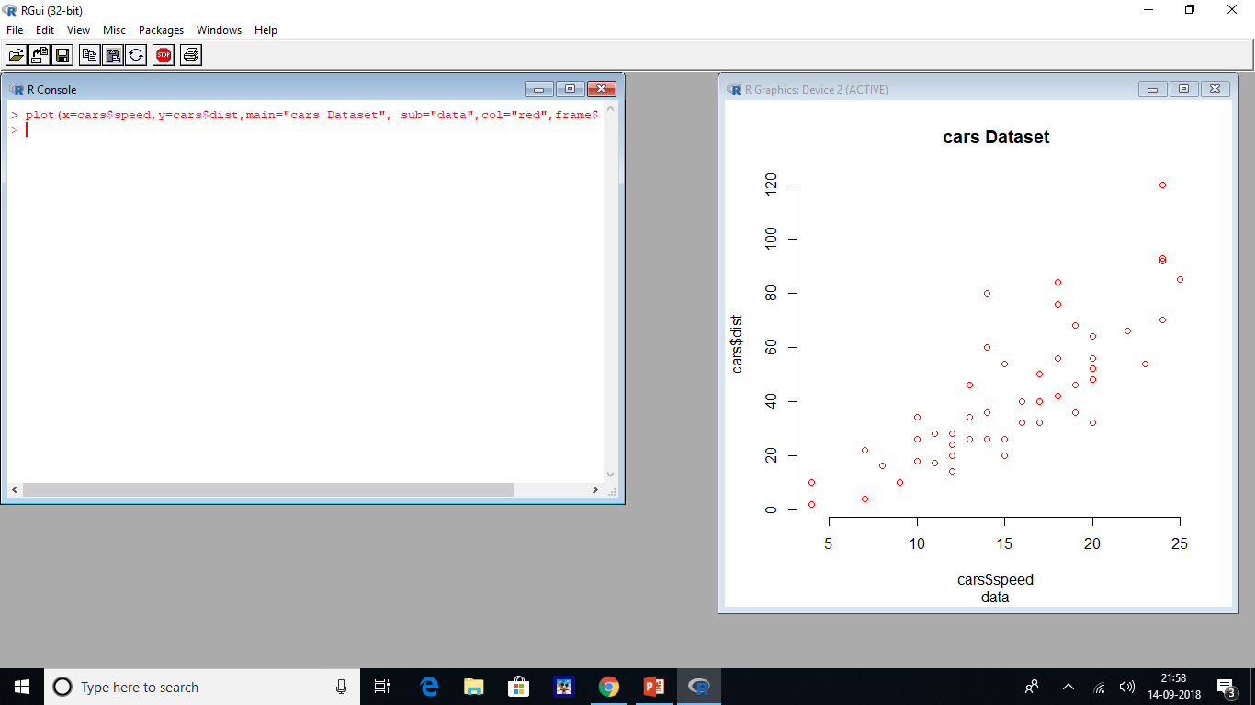

Slide 95
Case c)considering the parameters xlab,ylab,xlim,ylim,x,y,sub and main
i)xlab---speed
ii)ylab---distance
iii)xlim—argument displays values till a specific limit on the x-axis takes(x1,x2) as input values ,where x1,x2 are numbers here were pasing c(0,20)
iv)ylim---argument displays values till a specific limit on y-axis takes(x1,x2) as input values where x1 and y2 are numbers;here we are passing c(0,60).
> plot(x=cars$speed,y=cars$dist,main="cars Dataset", sub="data",col="red",frame.plot=FALSE,xlab="speed",ylab="Distance",xlim=c(0,20),ylim=c(0,60))

Slide 96


Slide 97
Case d) considering the aspect ratio (asp)parameter
i)To make the x & y axes the same size we can use aspect ratio;here we are assigning asp=5/10
> plot(x=cars$speed,y=cars$dist,main="cars dataset",sub="Data",col="red",asp=5/10,frame.plot=FALSE, xlab="speed", ylab="Distance",xlim=c(0,20), ylim=c(0,60))

Slide 98


Slide 99
Case e)Considering the axes parameters
i)To disable the x and y axes we need to set the axes argument as FALSE
> plot(x=cars$speed, y=cars$dist, main="Cars Dataset", sub="Data", col="red", axes=FALSE, xlab="Speed", ylab="Distance")

Slide 100
